Slide 1

WELCOME
Objective
Contents
Overview
Tools
DFD
Future
ER-Diagram
Limitations
Conclusion
Canteen Management System
Presented by Vidya Surbhi, Srijan Lal and Rahul Mehta

Slide 2

Heartful gratitude
Sincere GratituDe
Project Guide:
Shyamali Rani
Conclusion
ER-Diagram
Limitations
Future
DFD
Objective
Tools
Overview
Mr.Avinash Kumar Vimal ,HOD
R.K.Jha ,Profe.
Suryabala Ma’am
And All Professors
of
BCA department
Acknowledge

Slide 3

Introduction
Objective
Tools
ER-Diagram
DFD
Interface
Limitations
Future Scope
Conclusion
2014
2
DFD
Overview
Contents
Tools
Acknowledge
Limitations
Objective
Future
ER-Diagram
Conclusion

Slide 4
Introduction
The Canteen Management System for St. Michael’s School is software developed for helping in managing the school canteen properly in a very modern and accurate way .
The main objective of the software is to generate different types of reports and keep record of daily basis demand and supply information. And it also keeps all these data secure and arranged in such a manner that it can be easily searched for future use.
This project keeps track of all the bills, food items, stocks, sales, staff and annual report and keep data in very restrict or secured manner .
ER-Diagram
Contents
Tools
Objective
about
Overview

Slide 5
01
02
03
Manage every records digitally
Get rid of any kind of paper work
Highly secured system
Tools
Overview
ER-Diagram
Objective
Contents
04
05
06
Acknowledge
Provide every report systematically
Take control over every function of canteen
Entering data and printing reports easily

Slide 6
Operation System
Windows
7 or 10
Front End
Java 12.0
JAVA
Acknowledge
Overview
Tools
Contents
ER-Diagram
Objective
Back End
0racle 11g
Oracle

Slide 7
Fig -01
User
Manage
Item
Overview
DFD
Tools
Acknowledge
Objective
Has
ER-Diagram
Stocks
Sales
Bill

Slide 8
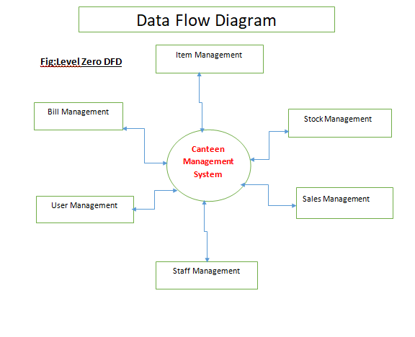
DFD
DFD
history
services
teams
timeline
about

Slide 9
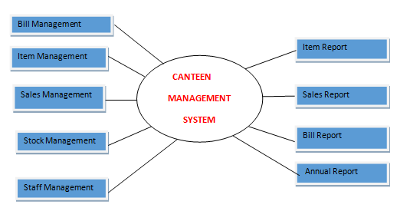
DFD
history
services
teams
timeline
about
Fig 02

Slide 10
Just a Desktop Based Application Software.
Our software is designed in window form i.e. desktop form, that can be run on the desktop only.
services
history
teams
We may not be able to substitute a desktop application with a web based application.
Excel report has not been developed.
The transactions are executed in off-line mode.
Limitations
timeline
about

Slide 11
This project is designed to be used at the School Canteen so we can add some advance features like calculating calories of every food item to give only nutritious food to students.
DFD
Tools
ER-Dig
Limitations
Objective
Future Scope

Slide 12
The idea of making this software after having so many software already in market that this software is really very user friendly and manage data in very simple, gentle and nudge way .
Overview
Objective
ER-Diagram
DFD
Tools
Conclusion

